Slide 1
User-Aided Encryption using Virtual Password Mechanism.

Slide 2
1st Batch - II
Team members:
Project Guide:
Sudhasree.V
(090606112055)
Vaishnavi.G
(090606112059)
Geetha.N (M.E)

Slide 3
Abstract:
Propose - virtual password – human computing – online environments.
User-determined randomized linear functions.
Defends - phishing - key logger - shoulder surfing.
Virtual password - defend all attacks together.

Slide 4
Objective:
The objective is to design less complex but secure virtual functions.
The function should be unobservable.
The function should be insolvable.

Slide 5
Existing system:
Users - Internet, - face - kinds of attacks.
E.g., a user ID and password - stolen and misused.
Disadvantages:
The SSL/TLS – still – weak - protection - plaintext password and user ID.
Still vulnerable to attacks.

Slide 6
Proposed system:
To confront - propose - concept of virtual password.
Virtual password – generates a dynamic password - submitted - authentication.
Advantages:
Defend against all attacks simultaneously.

Slide 7
Modules:
There are 7 modules:
User module:
Registration, Login, Passport application, View status.
Admin module:
Login, View passport, Update status.

Slide 8
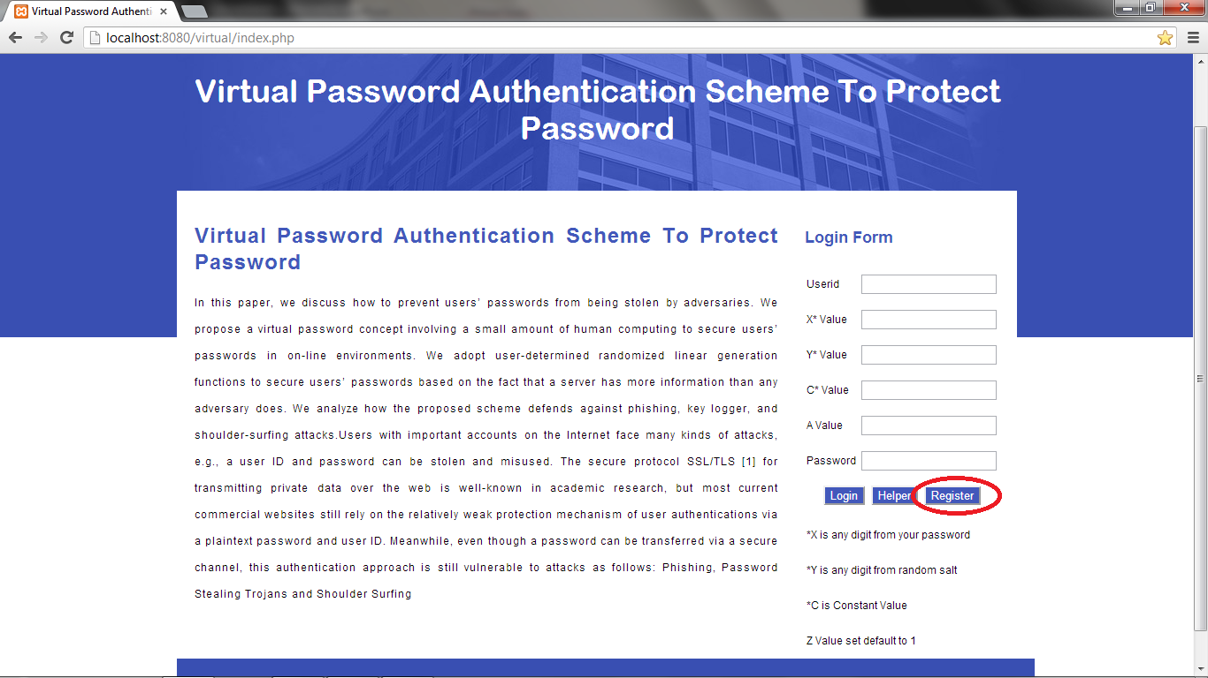
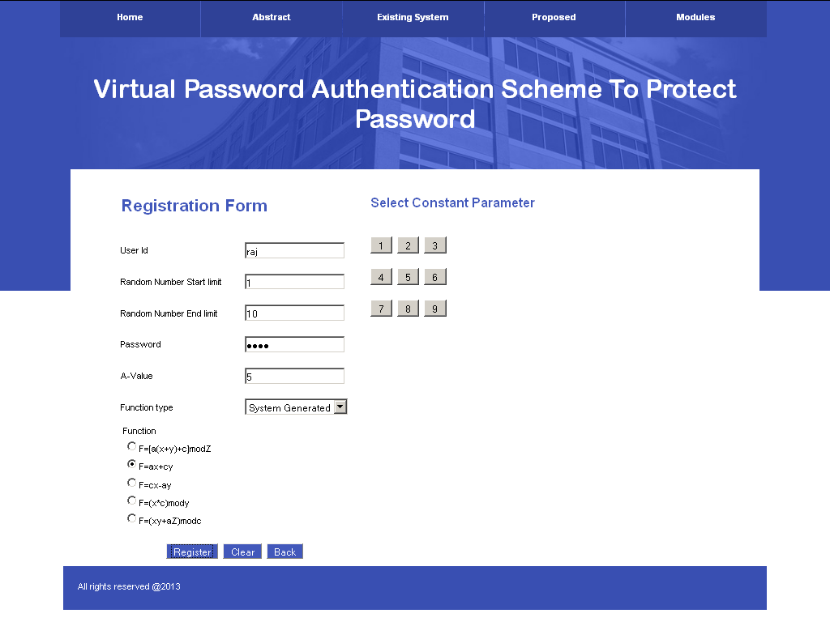
User registration:

Slide 9
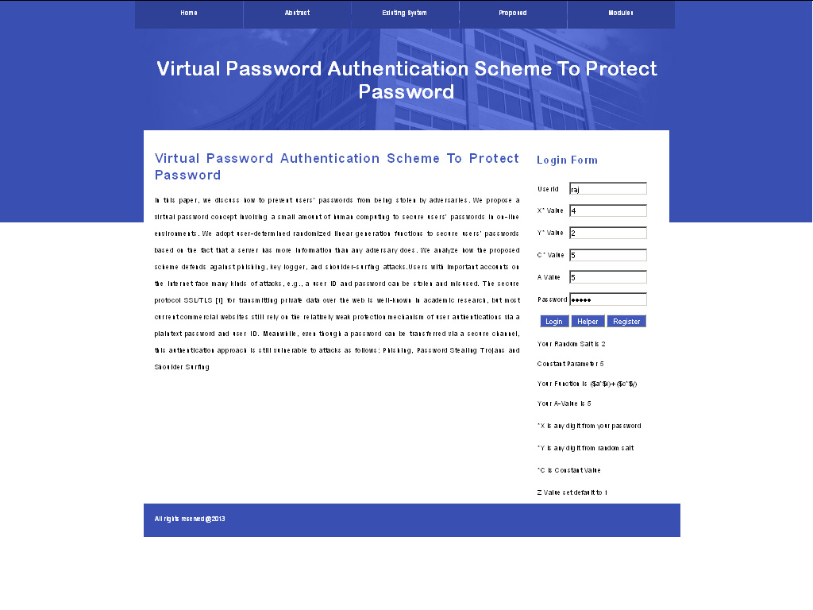
User login:

Slide 10
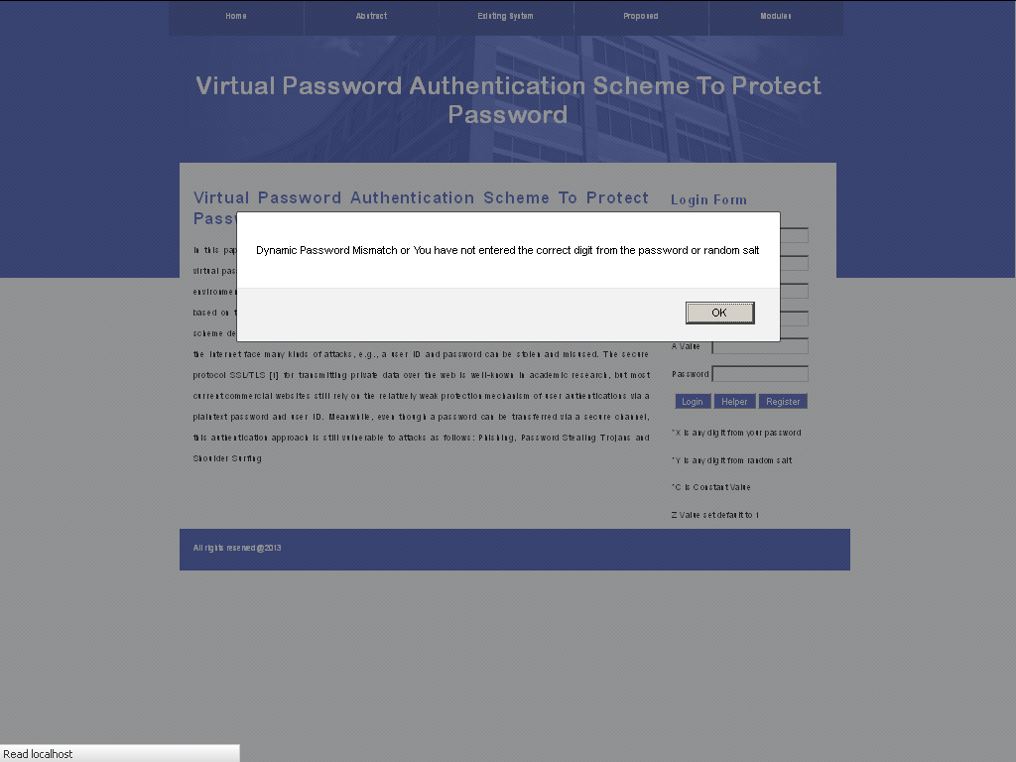
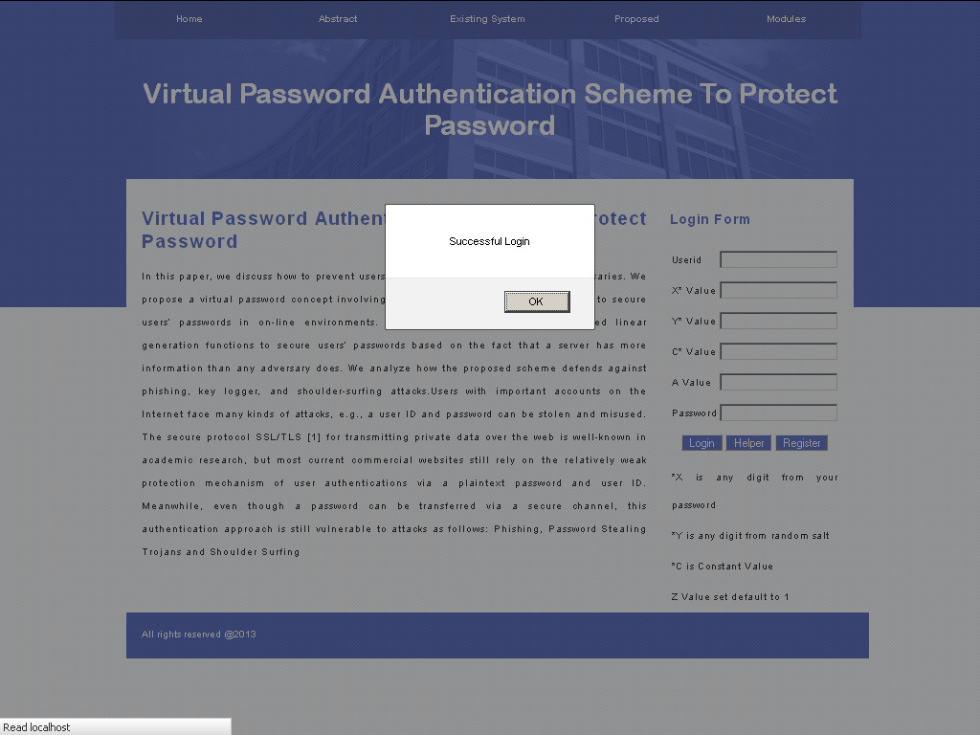

Slide 11
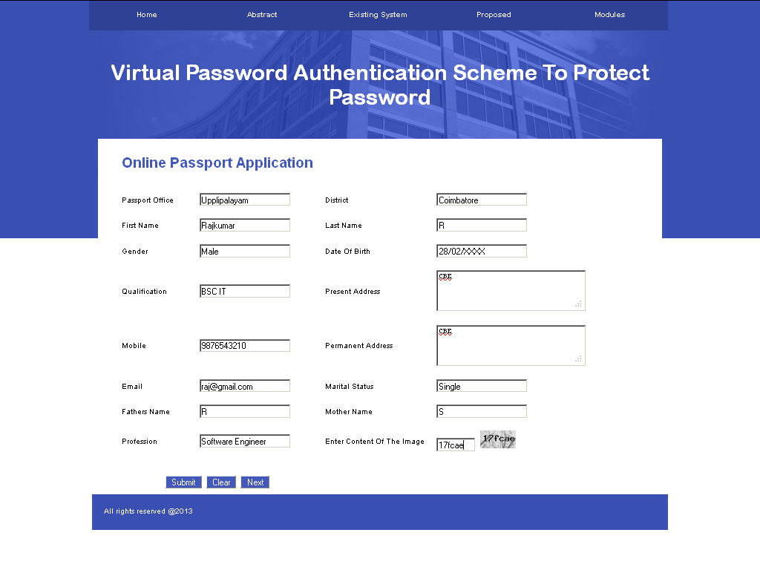
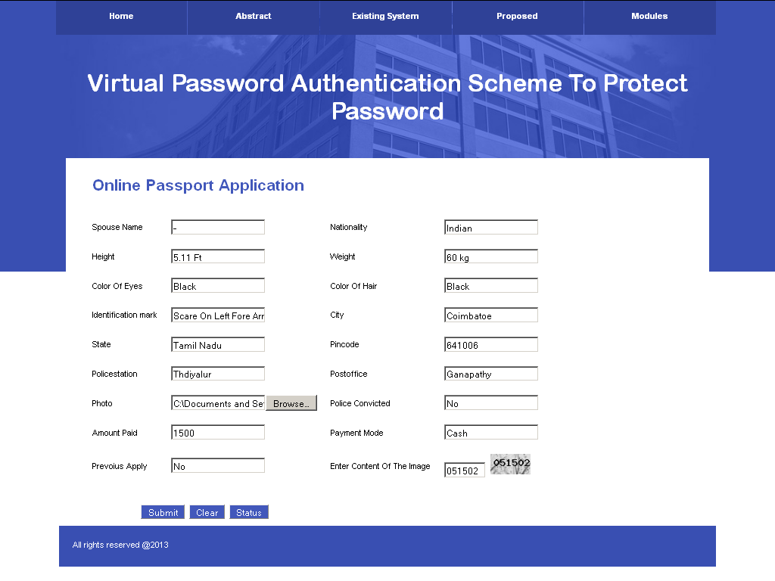
Passport application:

Slide 12
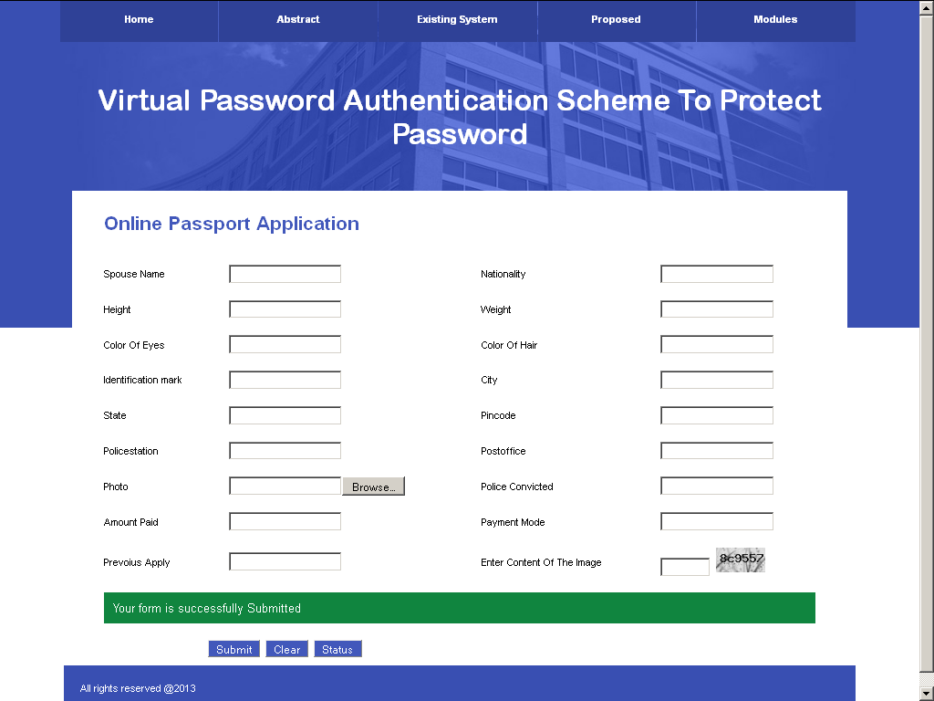

Slide 13
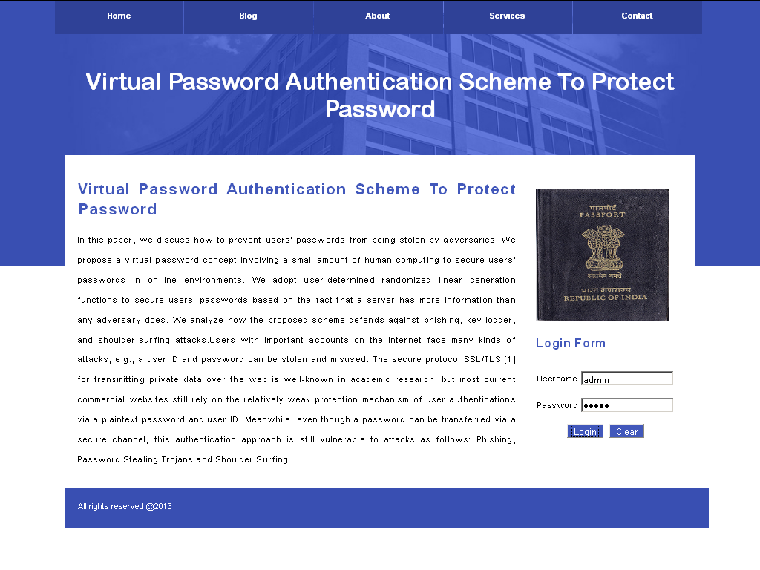
Admin login:

Slide 14
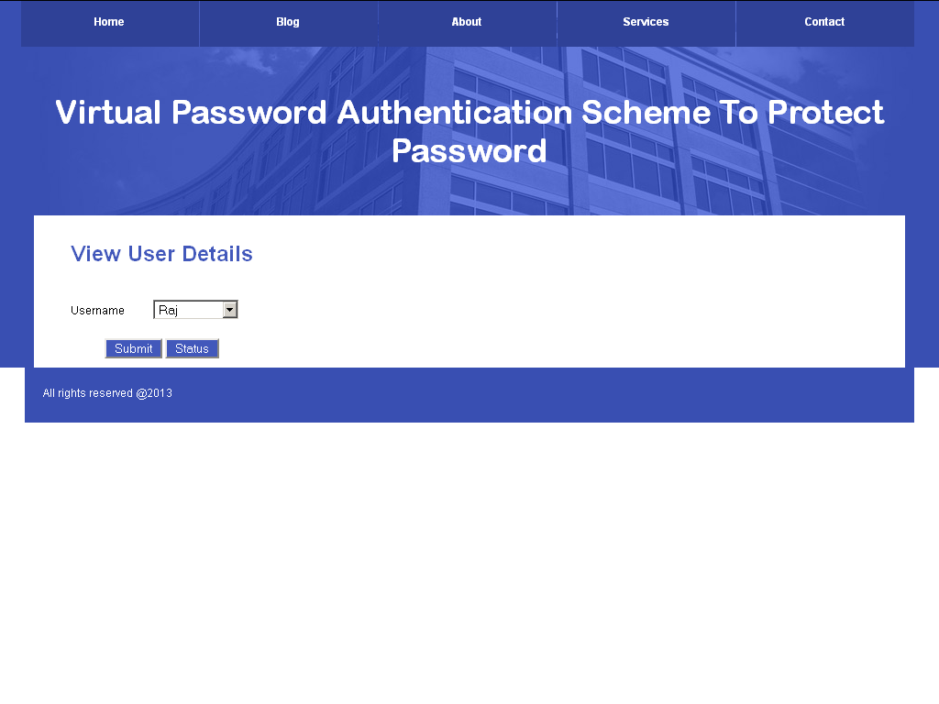
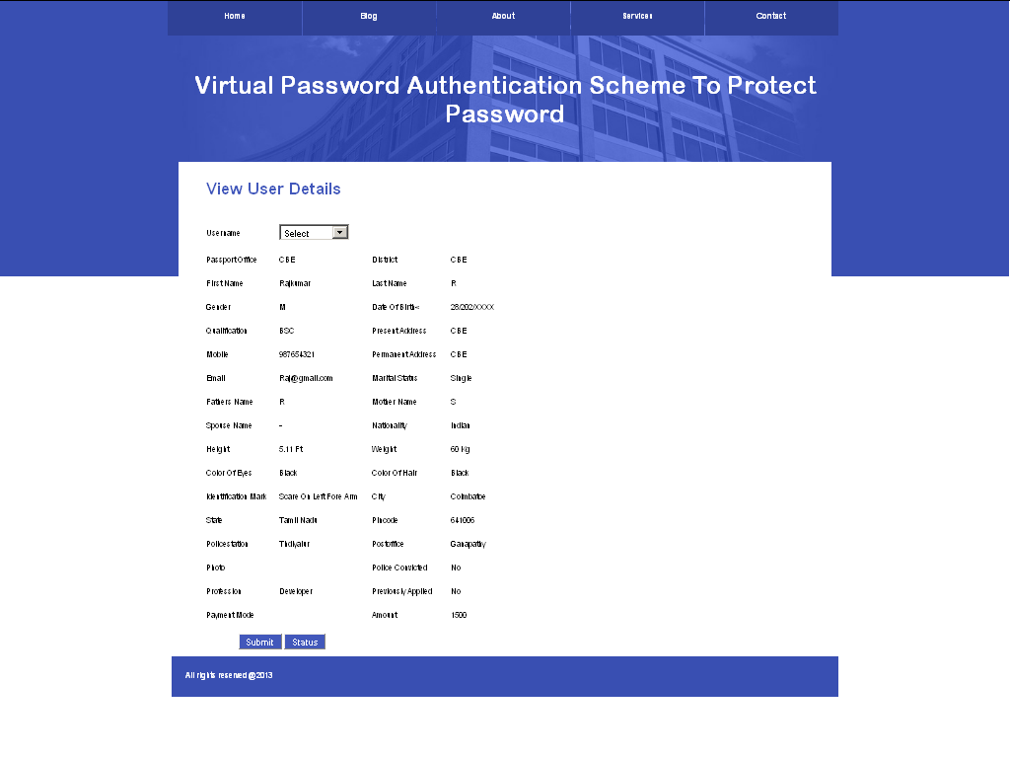
View user details:

Slide 15
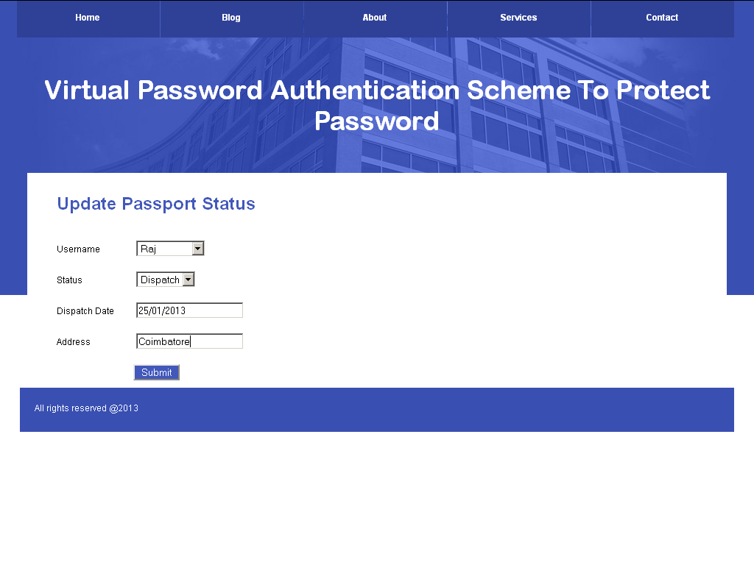
Update status:

Slide 16
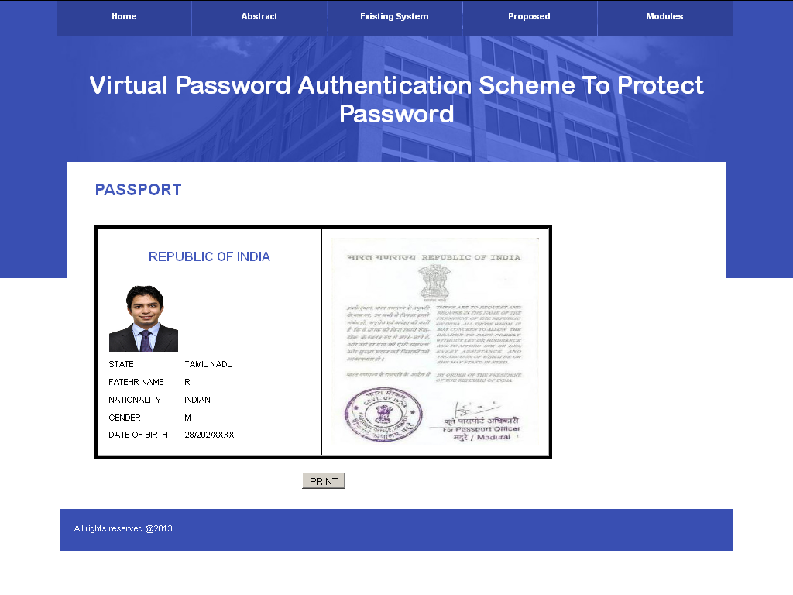
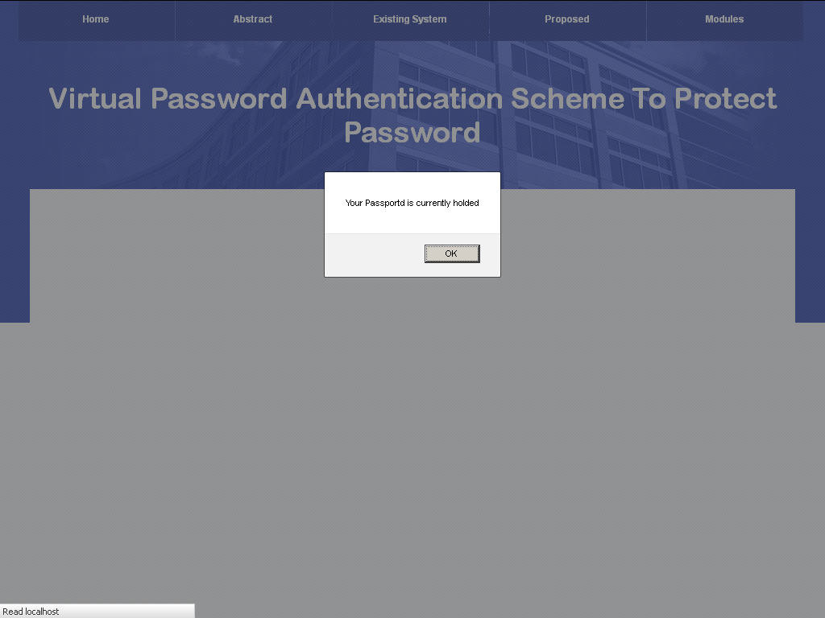
View status:

Slide 17
Conclusion:
We conclude – proposed - provide security.
Also - defend against attacks.
Adopted secret little functions - enhance security - hides secret functions.
Especially – computer - insecure environment - Internet cafe.

Slide 18
Future Enhancements:
In future - we plan - how to design smarter functions - reduces – computation.
Also develop - small applications - with virtual passwords - runs - customer’s wireless device.

Slide 19
Queries ?
Thanking You!!!

